Slide 1
L3
OP-AMPLIFIER

Slide 2
INTRODUCTION TO OPERATIONAL AMPLIFIERS
Early operational amplifiers (op-amps) were used primarily to perform mathematical
operations such as addition, subtraction, integration, and differentiation—thus the
term operational. These early devices were constructed with vacuum tubes and
worked with high voltages. Today’s op-amps are linear integrated circuits (ICs) that
use relatively low dc supply voltages and are reliable and inexpensive.

Slide 3
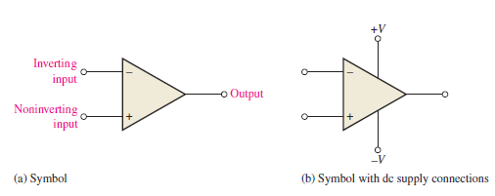
The standard operational amplifier (op-amp) symbol is shown in Figure 12–1(a). It has two input terminals, the inverting (-) input and the noninverting (+) input, and one output terminal. Most op-amps operate with two dc supply voltages, one positive and the
other negative, as shown in Figure 12–1(b), although some have a single dc supply. Usually these dc voltage terminals are left off the schematic symbol for simplicity but are understood to be there. Some typical op-amp IC packages are shown in Figure 12–1(c).

Slide 4
The Ideal Op-Amp
To illustrate what an op-amp is, let’s consider its ideal characteristics. A practical op-amp, of course, falls short of these ideal standards, but it is much easier to understand and analyze the device from an ideal point of view. First, the ideal op-amp has infinite voltage gain and infinite bandwidth. Also, it has an infinite input impedance (open) so that it does not load the driving source. Finally, it has a zero output impedance. Op-amp characteristics are illustrated in Figure 12–2(a). The input voltage, Vin, appears between the two input terminals, and the output voltage is AvVin, as
indicated by the internal voltage source symbol. The concept of infinite input impedance is a particularly valuable analysis tool for the various op-amp configurations

Slide 5
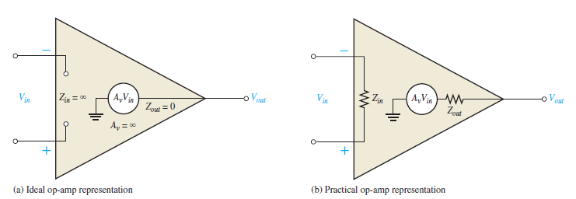
The Practical Op-Amp
Although integrated circuit (IC) op-amps approach parameter values that can be treated as ideal in many cases, the ideal device can never be made. Any device has limitations, and the IC op-amp is no exception. Op-amps have both voltage and current limitations. Peak to- peak output voltage, for example, is usually limited to slightly less than the two supply voltages. Output current is also limited by internal restrictions such as power dissipation and component ratings. Characteristics of a practical op-amp are very high voltage gain, very high input impedance, and very low output impedance. These are labelled in Figure 12–2(b). Another practical consideration is that there is always noise generated within the op-amp. Noise is an undesired signal that affects the quality of a desired signal. Today, circuit designers are using smaller voltages that require high accuracy, so low-noise components are in greater demand. All circuits generate noise; op-amps are no exception, but the amount can be minimized

Slide 6
Characteristics of a practical op-amp are very high voltage gain, very high input impedance, and very low output impedance. These are labelled in Figure 12–2(b). Another practical consideration is that there is always noise generated within the op-amp. Noise is an undesired signal that affects the quality of a desired signal. Today, circuit designers are using smaller voltages that require high accuracy, so low-noise components are in greater demand. All circuits generate noise; op-amps are no exception, but the amount can be minimized Internal Block Diagram of an Op-Amp A typical op-amp is made up of three types of amplifier circuits: a differential amplifier, a voltage amplifier, and a push-pull amplifier, as shown in Figure 12–3. The differential amplifier is the input stage for the op-amp. It provides amplification of the difference voltage between the two inputs. The second stage is usually a class A amplifier that provides additional gain. Some op-amps may have more than one voltage amplifier stage. A push-pull class B amplifier is typically used for the output stage.

Slide 7
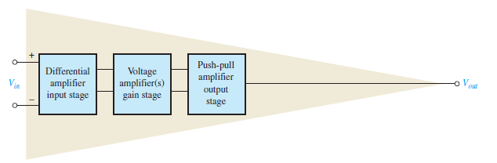
The differential amplifier was introduced in . The term differential comes from the amplifier’s ability to amplify the difference of two input signals applied to its inputs. Only the difference in the two signals is amplified; if there is no difference, the output is zero. The differential amplifier exhibits two modes of operation based on the type of input signals. These modes are differential and common, which are described in the next section. Since the differential amplifier is the input stage of the op-amp, the op-amp exhibits the same modes.

Slide 8
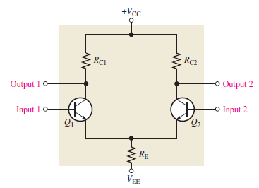
Basic Operation
A basic differential amplifier (diff-amp) circuit is shown in Figure 6–37. Notice that the differential amplifier has two inputs and two outputs.
The following discussion is in relation to Figure 6–38 and consists of a basic dc analysis of the diff-amp’s operation. First, when both inputs are grounded (0 V), the emitters are at -0.7V as indicated in Figure 6–38(a). It is assumed that the transistors are identically matched by careful process control during manufacturing so that their dc emitter currents are the same when there is no input signal. Thus,

Slide 9
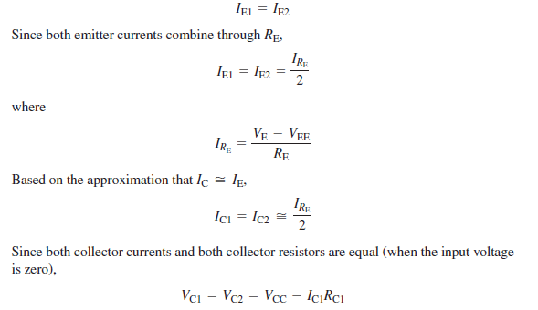
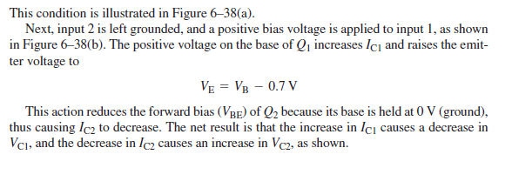

Slide 10
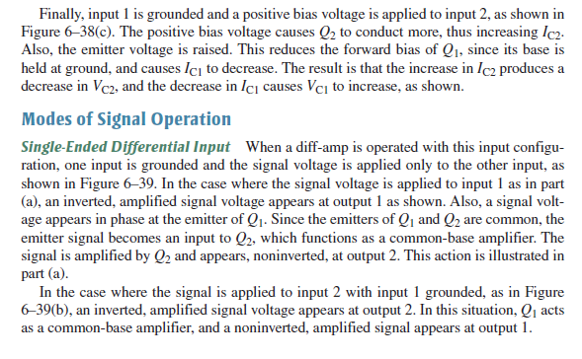

Slide 11
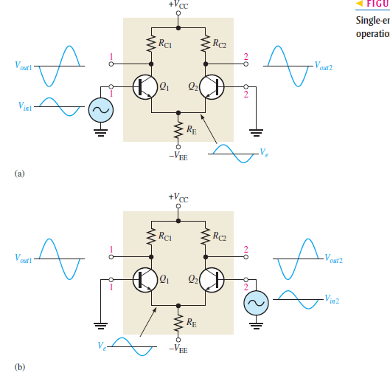

Slide 12
Double-Ended Differential Inputs :In this input configuration, two opposite-polarity
(out-of-phase) signals are applied to the inputs, as shown in Figure 6–40(a). Each input affects the outputs, as you will see in the following discussion. Figure 6–40(b) shows the output signals due to the signal on input 1 acting alone as a single-ended input. Figure 6–40(c) on page 308 shows the output signals due to the signal on input 2 acting alone as a single-ended input. Notice in parts (b) and (c) that the signals on output 1 are of the same polarity. The same is also true for output 2. By superimposing both output 1 signals and both output 2 signals, you get the total output signals, as shown
in Figure 6–40(d).

Slide 13
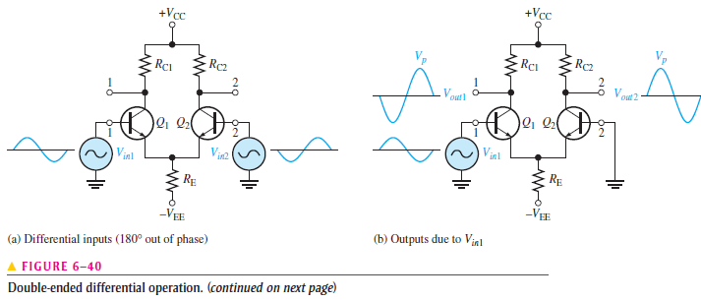

Slide 14
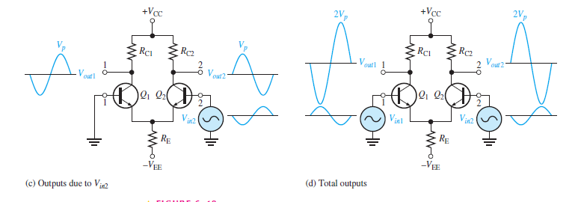

Slide 15
Common-Mode Inputs One of the most important aspects of the operation of a diffamp can be seen by considering the common-mode condition where two signal voltages of the same phase, frequency, and amplitude are applied to the two inputs, as shown in Figure 6–41(a). Again, by considering each input signal as acting alone, you can understand the basic operation.

Slide 16
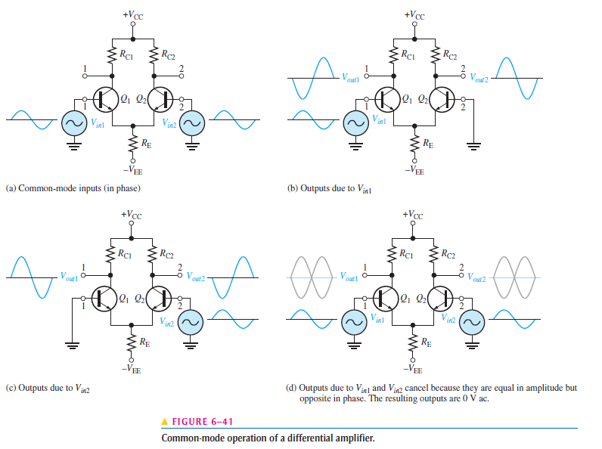

Slide 17

Op-Amp Parameters
Common-Mode Rejection Ratio ,Desired signals can appear on only one input or with opposite polarities on both input lines. These desired signals are amplified and appear on the output .Unwanted signals (noise) appearing with the same polarity on both input lines are essentially cancelled by the op-amp and do not appear on the output. The measure of an amplifier’s ability to reject common-mode signals is a parameter called the CMRR (common-mode rejection ratio).
Ideally, an op-amp provides a very high gain for differential-mode signals and zero gain for common-mode signals. Practical op-amps, however, do exhibit a very small common-mode open-loop differential voltage gain, Aol, to the common-mode gain, Acm.

Slide 18
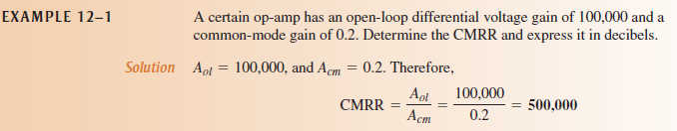
Input Offset Voltage ,The ideal op-amp produces zero volts out for zero volts in. In a practical op-amp, however, a small dc voltage, VOUT(error), appears at the output when no differential input voltage is applied. Its primary cause is a slight mismatch of the base-emitter voltages of the differential amplifier input stage of an op-amp. As specified on an op-amp datasheet, the input offset voltage, Vos, is the differential dc voltage required between the inputs to force the output to zero volts. Typical values of input offset voltage are in the range of 2 mV or less. In the ideal case, it is 0 V.

Slide 19
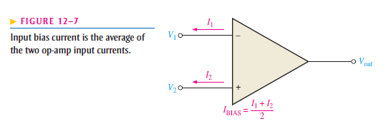

Input Bias Current You have seen that the input terminals of a bipolar differential amplifier
are the transistor bases and, therefore, the input currents are the base currents.
The input bias current is the dc current required by the inputs of the amplifier to properly operate the first stage. By definition, the input bias current is the average of both input currents and is calculated as follows:
The concept of input bias current is illustrated in
Figure 12–7.

Slide 20
Input Impedance, Two basic ways of specifying the input impedance of an op-amp are the differential and the common mode. The differential input impedance is the total resistance between the inverting and the noninverting inputs, as illustrated in Figure
12–8(a).Differential impedance is measured by determining the change in bias current for a given change in differential input voltage. The common-mode input impedance is the resistance between each input and ground and is measured by determining the change in bias current for a given change in common-mode input voltage. It is depicted in Figure 12–8(b
).

Slide 21
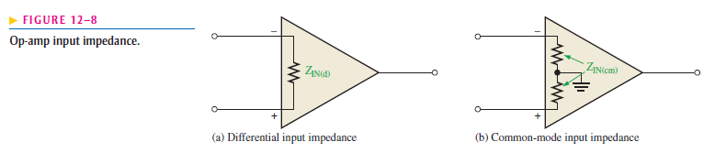

Input Offset Current ,Ideally, the two input bias currents are equal, and thus their difference is zero. In a practical op-amp, however, the bias currents are not exactly equal. The input offset current, Ios, is the difference of the input bias currents, expressed as an absolute value.

Slide 22
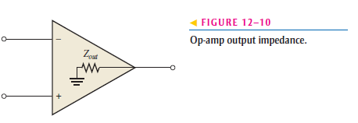

Output Impedance, The output impedance is the resistance viewed from the output terminal of the op-amp, as indicated in Figure 12–10.
Slew Rate The maximum rate of change of the output voltage in response to a step input voltage is the slew rate of an op-amp. The slew rate is dependent upon the high-frequency response of the amplifier stages within the op-amp.

Slide 23
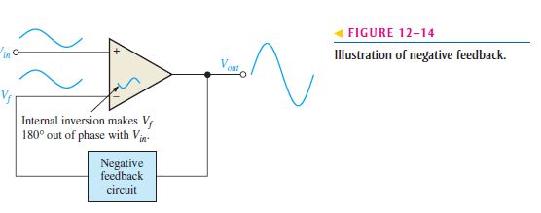
NEGATIVE FEEDBACK
Negative feedback is one of the most useful concepts in electronics, particularly in op-amp applications. Negative feedback is the process whereby a portion of the output voltage of an amplifier is returned to the input with a phase angle that opposes (or subtracts from) the input signal Negative feedback is illustrated in Figure 12–14. The inverting input effectively
makes the feedback signal 180° out of phase with the input signal. (-)

Slide 24

Why Use Negative Feedback?
As you can see in Table 12–1, the inherent open-loop voltage gain of a typical op-amp is very high (usually greater than 100,000). Therefore, an extremely small input voltage drives the op-amp into its saturated output states. In fact, even the input offset voltage of
the op-amp can drive it into saturation. For example, assume VIN = 1 mV and Aol =100,000. Then,
Since the output level of an op-amp can never reach 100 V, it is driven deep into saturation and the output is limited to its maximum output levels, as illustrated in Figure 12–15 for both a positive and a negative input voltage of 1 mV.

Slide 25
OP-AMPS WITH NEGATIVE FEEDBACK
An op-amp can be connected using negative feedback to stabilize the gain and increase frequency response. Negative feedback takes a portion of the output and applies it back out of phase with the input, creating an effective reduction in gain. This closed loop gain is usually much less than the open-loop gain and independent of it.
Closed-Loop Voltage Gain, Acl
The closed-loop voltage gain is the voltage gain of an op-amp with external feedback. The amplifier configuration consists of the op-amp and an external negative feedback circuit that connects the output to the inverting input. The closed-loop voltage gain is determined
by the external component values and can be precisely controlled by them.

Slide 26
BIAS CURRENT AND OFFSET VOLTAGE
Certain deviations from the ideal op-amp must be recognized because of their effects on its operation. Transistors within the op-amp must be biased so that they have the correct values of base and collector currents and collector-to-emitter voltages. The ideal op-amp has no input current at its terminals; but in fact, the practical op-amp has small input bias currents typically in the nA range. Also, small internal imbalances in the transistors effectively produce a small offset voltage between the inputs.
These non ideal parameters were described in Section 12–2.

Slide 27
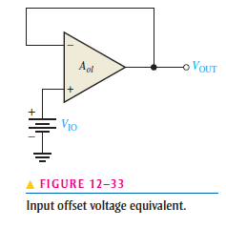
Input Offset Voltage Compensation
Most integrated circuit op-amps provide a means of compensating for offset voltage. This is usually done by connecting an external potentiometer to designated pins on the IC package, as illustrated in Figure 12–34(a) and (b) for a 741 op-amp. The two terminals are labelled offset null. With no input, the potentiometer is simply adjusted until the output voltage reads 0, as shown in Figure 12–34(c).

Slide 28
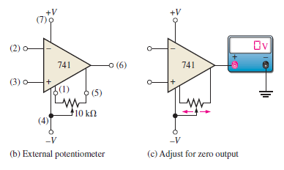
Input Offset Voltage Compensation
Most integrated circuit op-amps provide a means of compensating for offset voltage. This is usually done by connecting an external potentiometer to designated pins on the IC package, as illustrated in Figure 12–34(a) and (b) for a 741 op-amp. The two terminals are labelled offset null. With no input, the potentiometer is simply adjusted until the output voltage reads 0, as shown in Figure 12–34(c).

